Slide 1


E-COMMERCE
OLIST STORE ANALYSIS
Team Members (Group-1):
Kunal Rajbhar
Harmeek Singh
Kanchan Gohad
Roshni Shrivastav
Akashdeep Fagare
K. Shyam Sundar
Mentor Name:
Dipti Sinha

Slide 2
TABLE OF CONTENTS
01
INTRODUCTION
DATSETS
PROJECT PROCESS
TOOLS USED FOR ANALYSIS
KPI’S
DASHBOARD IMAGES (EXCEL, TABLEAU, POWER BI)
INSIGHTS
RECOMMENDATIONS
CONCLUSION
02
03
04
05
06
07
08
09

Slide 3
INTRODUCTION
Overview: In-depth look at various aspects of the store's performance, customer behavior, and sales trends.
Objective: The main goal of this analysis is to uncover key insights that can help in making informed business decisions, enhancing customer satisfaction, and optimizing sales strategies.
Company Background: Olist is a Brazilian e-commerce platform that connects small and medium-sized businesses to major online retailers, enabling them to reach a wider audience and boost their sales.
Market Position: With a strong presence in the Brazilian market, Olist helps thousands of sellers grow their online businesses through its comprehensive platform.

Slide 4

DATASETS
olist_customers_dataset
olist_geolocation_dataset
olist_orders_items_dataset
olist_orders_payments_dataset
olist_orders_reviews_dataset
olist_orders_dataset
olist_products_dataset
olist_sellers_dataset
product_category_name_translation

Slide 5
PROJECT PROCESS
Extract Data:
Transformation:
1
2
Gather raw data from Olist's databases. Ensure comprehensive data collection covering all necessary aspects.
Clean and prepare data.
Handle missing values, remove duplicates, correct errors.
Standardize data formats.
KPI & Visualization:
Dashboard:
3
4
Identify KPIs: Total sales, number of orders, review scores, payment types.
Create charts and graphs to represent data trends.
Develop an interactive dashboard to present findings.
Design layout for clarity and impact.

Slide 6




TOOLS USED FOR ANALYSIS
EXCEL
Power BI

Slide 7
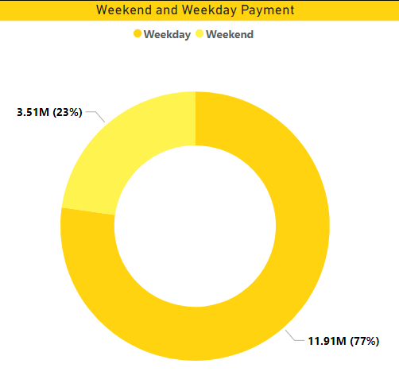
KPI 1: Weekday vs Weekend payment statistics
Observation :
The payment done in weekday is 77% and weekend is 23%, which is representing highest payment on weekday as compared to weekend.
The weekdays payment is 3.4 times of weekend payment.
Conclusion :
Businesses can optimize their strategies to capitalize on higher payment volumes during weekdays, while also considering targeted approaches to boost weekend payments.
To increase the weekend sales we can release any special offers on the weekends which helps to generate more revenue.
Analyzing weekdays versus weekends enables customer segmental on allowing for personalized marketing approaches to reach customers effectively on the days when they are more likely to make purchases.

Slide 8
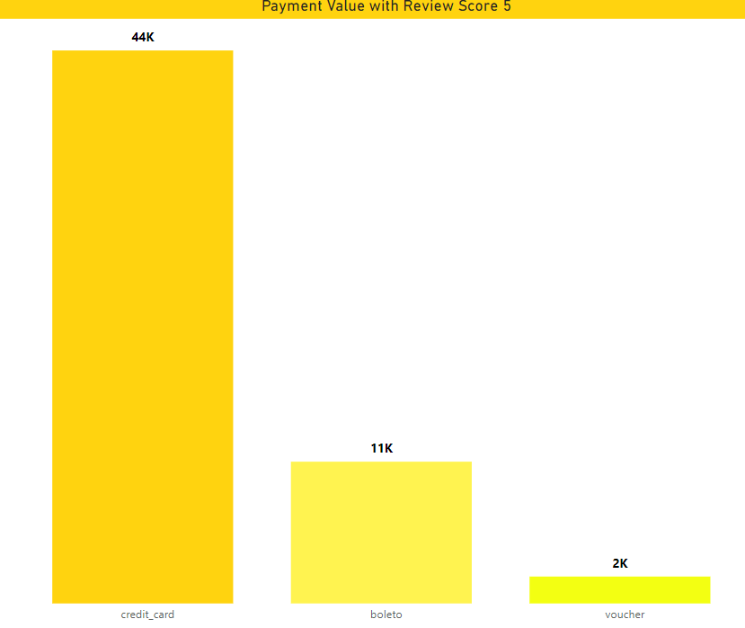
KPI 2: Number of orders with review score 5 and payment type credit card
Observation:
With a review score of 5 and payment type as a credit card, highest order has been received .
More than 70% of sales were paid by Credit Card which is
increasing customer satisfaction also.
Conclusion:
The prevalence of credit card payments and high review scores reflects positive customer experiences.
The high number of orders signifies a strong demand for the products or services offered.
Company can tie-up with any bank for promoting credit-card in shop.

Slide 9
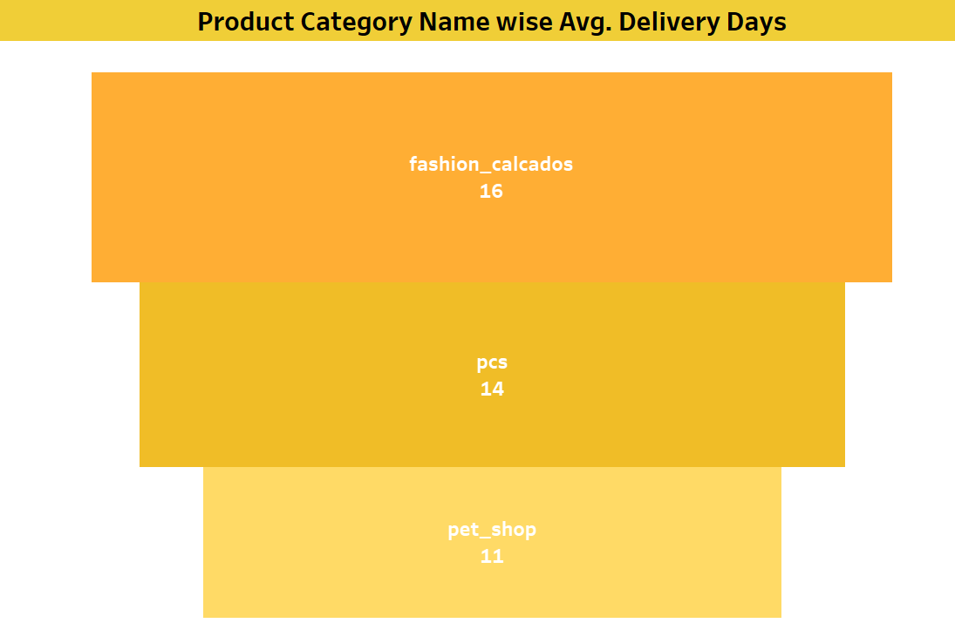
KPI 3: Average number of days taken for order_delivered_customer_date for pet_shop
Observation:
11 days is the avg days taken to deliver the order for pet shop.
Conclusion:
The observation highlights the need for streamlining processes and improving operational efficiency at the pet shop.
Enhancing efficiency can lead to shorter waiting times for customers and increased satisfaction.
Identifying bottlenecks or inefficiencies in the work flow can help the pet shop streamline operators, reduce delays, and improve overall productivity.

Slide 10
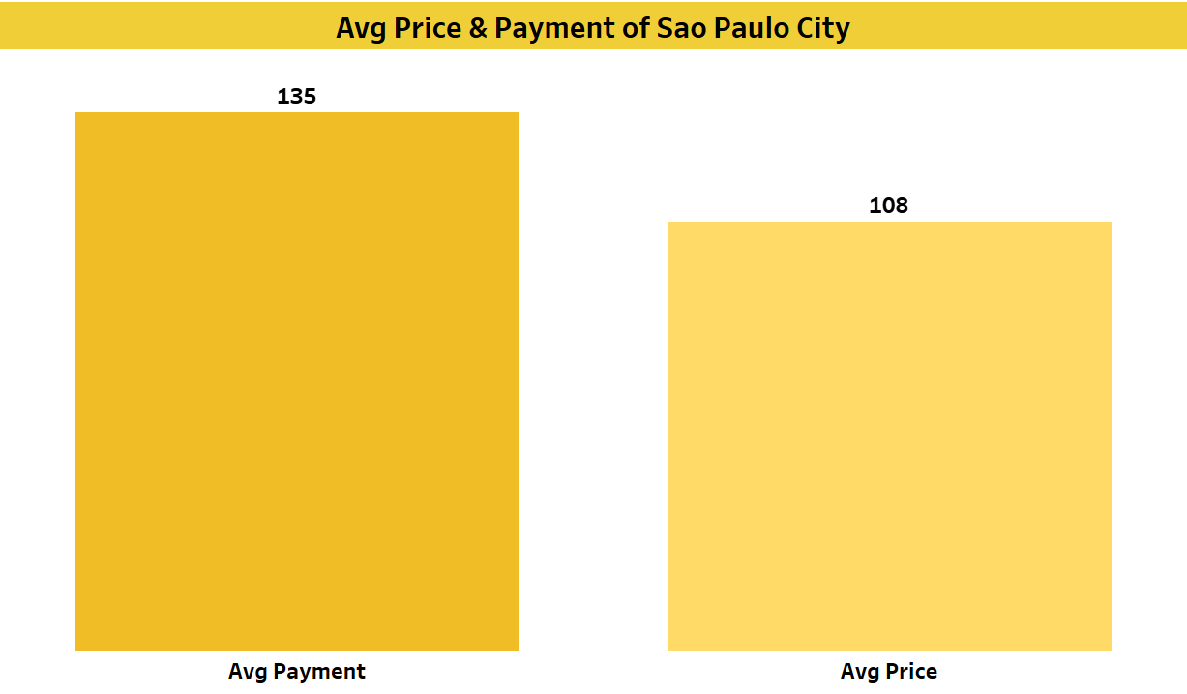
KPI 4: Average price and payment values from customers of sao paulo city
Observation:
The payment is more as compared to price of the product.
Customer paying 41% extra for products.
Conclusion:
The highest payment value compared to price suggests that consumers in São Paulo City are willing to spend more than the average price for goods or services.
This observation may indicate a relatively affluent consumer base or a preference for higher-end products or services in the city.
To increase sales on other cities we can work on faster delivery and easy payment modes and product wise offers.

Slide 11
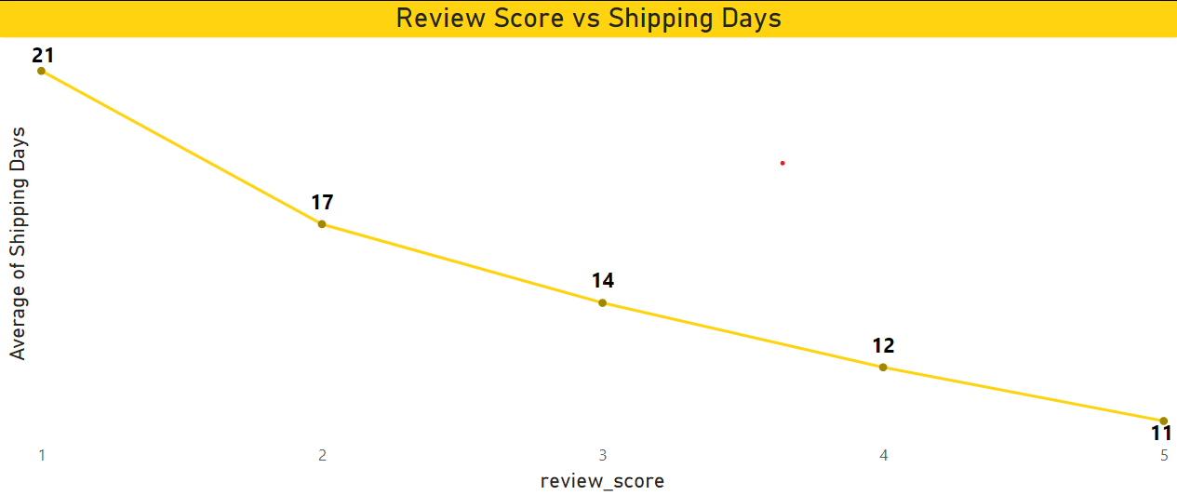
KPI 5: Relationship between shipping days vs review scores
Observation:
Less shipping days is having highest review score.
Highest shipping days is having less review score.
Customer satisfaction is based on shipping days.
Conclusion:
The observation suggests a correlation between shipping efficiency and customer satisfaction levels.
Businesses that can deliver orders more quickly tend to receive higher review scores, indicating greater customer satisfaction.

Slide 12
DASHBOARD IMAGES

Slide 13
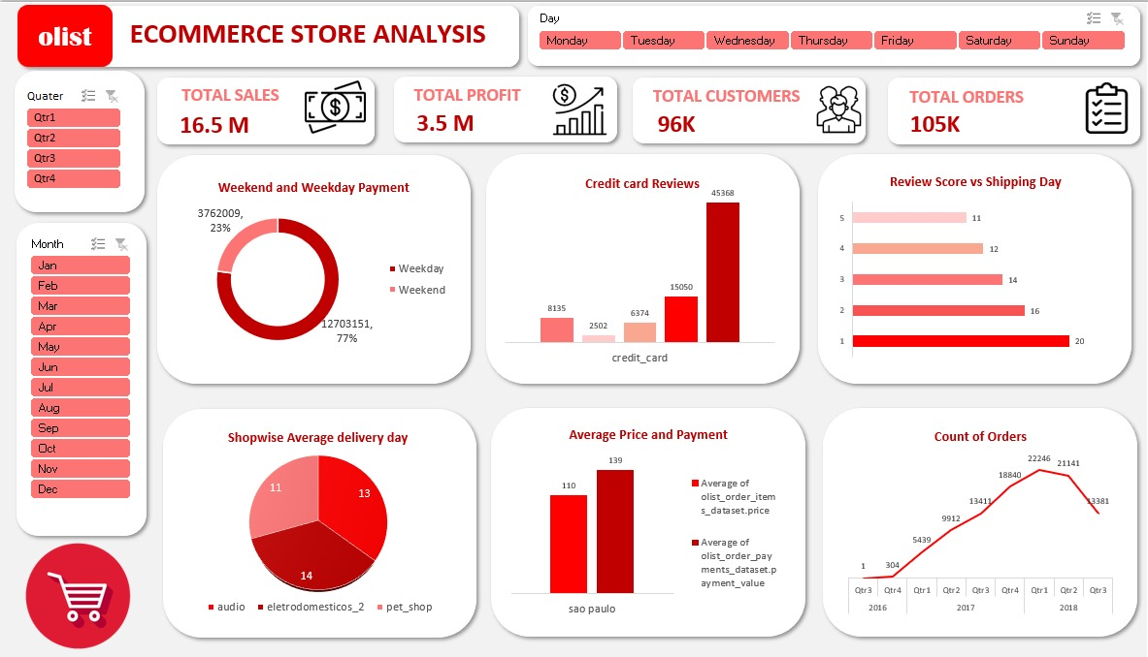
EXCEL DASHBOARD

Slide 14
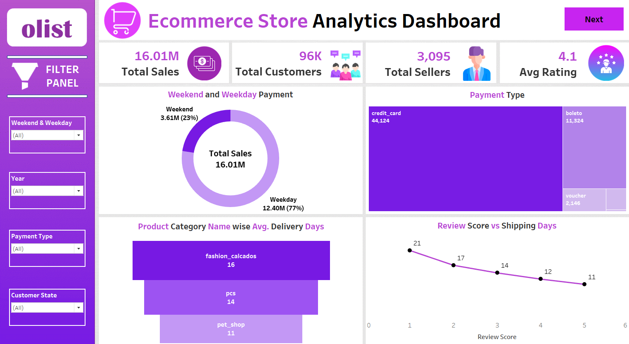
TABLEAU DASHBOARD PAGE-1

Slide 15
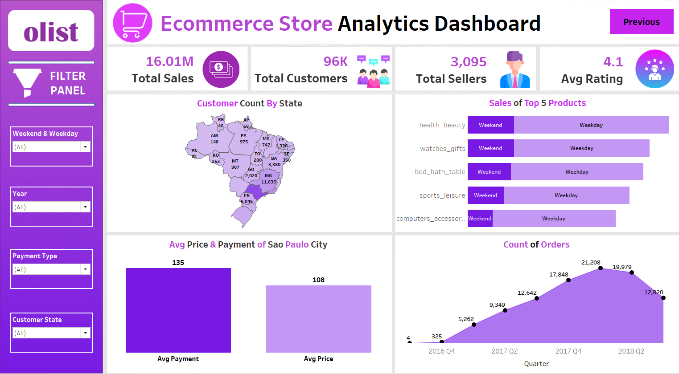
TABLEAU DASHBOARD PAGE-2

Slide 16
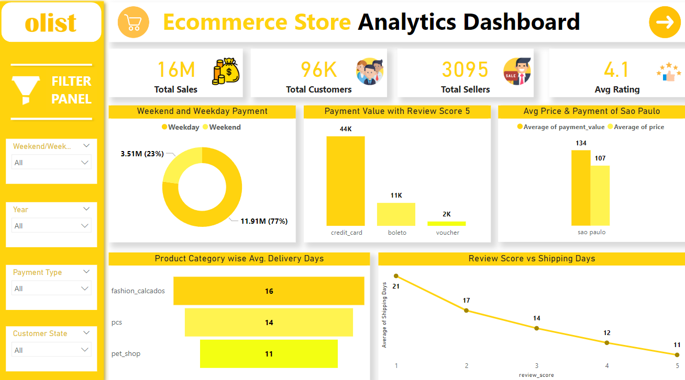
POWER BI DASHBOARD PAGE-1

Slide 17
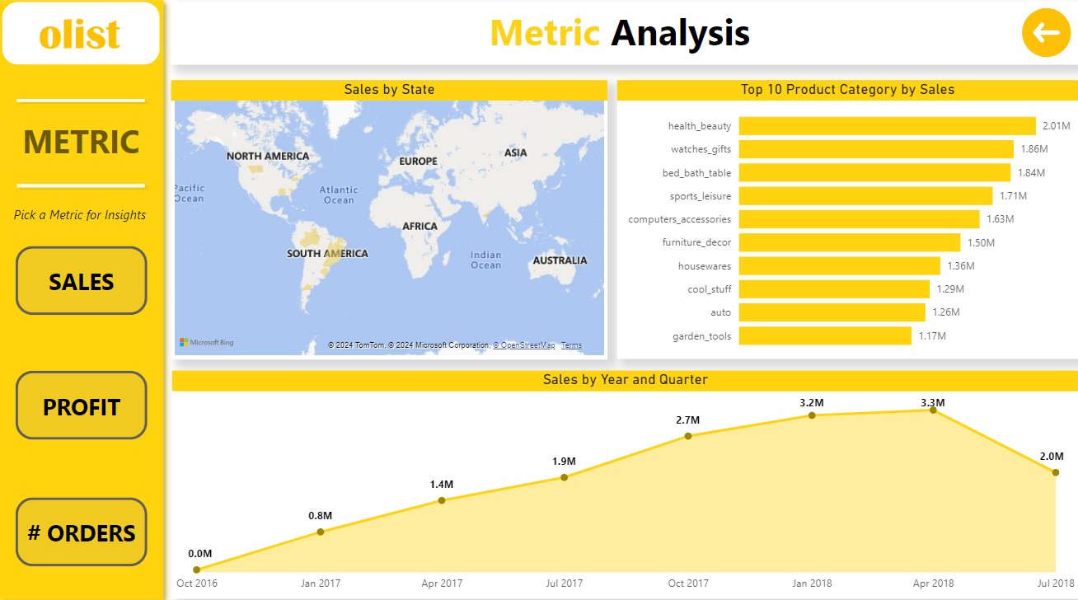
POWER BI DASHBOARD PAGE-2

Slide 18
INSIGHTS
According to the data, Olist E-commerce has about 16.5M total sales & has 3.5M profit. Total customers are around 96k and total orders are about 105k.With about 90k orders being delivered, the company has 90% of delivery success rate. The average product rating is 4 star with product categories going as high as 4.8 star and as low as 2 star. Count of orders also varies in every quarter of the year. Weekend the sales are more than double that of weekday sales.
Insights from this analysis can help in making business decisions, such as focusing on the products customers are more interested in, improving product and service quality, and optimising marketing in provinces with high total sales. In addition this analysis also provides an overview of customer consumption trends and patterns that can be used to direct further business strategies.

Slide 19
RECOMMENDATIONS
Regularly monitor and analyze customer reviews to gain insights in product quality and identify areas for improvement. Dashboards can be used to identify patterns in customer reviews. This will provide a data –driven approach to enhance customer experience.
Investigate delivery delays and undelivered orders. Analyzing geographic locations could bring insights about certain challenges with demographic, accessibility and possible route optimization. Tracking fleet performance with the use of telematics can identify issues before they become a problem.
Providing a proper shipment tracking system aids in having clear and concise communications between customer, sellers and couriers. Regular updates can set proper expectations among customers and specific delivery instructions of customers can be properly accommodated. By establishing trust and communications, both parties can work together to resolve any issue that may arise.

Slide 20

CONCLUSION
The Olist Store Analysis project provides valuable insights into customer behavior and payment statistics.
The analysis of these KPIs helps Olist in identifying areas of improvement and creating targeted marketing campaigns.
As a data analyst, we used 'Excel', 'Power BI' and 'Tableau' to clean and manipulate the dataset and create meaningful visualizations.
This project serves as a great example of how data analysis can help businesses make informed decisions.

Slide 21

THANK YOU
Team Members:
Kunal Rajbhar
Harmeek Singh
Kanchan Gohad
Roshni Shrivastav
Akashdeep Fagare
K. Shyam Sundar

